Slide 1
Twitter's Reaction on Revelations about Government's Internet Surveillance Program
Shirin Nilizadeh
Indiana University Bloomington
SAT 2015

Slide 2
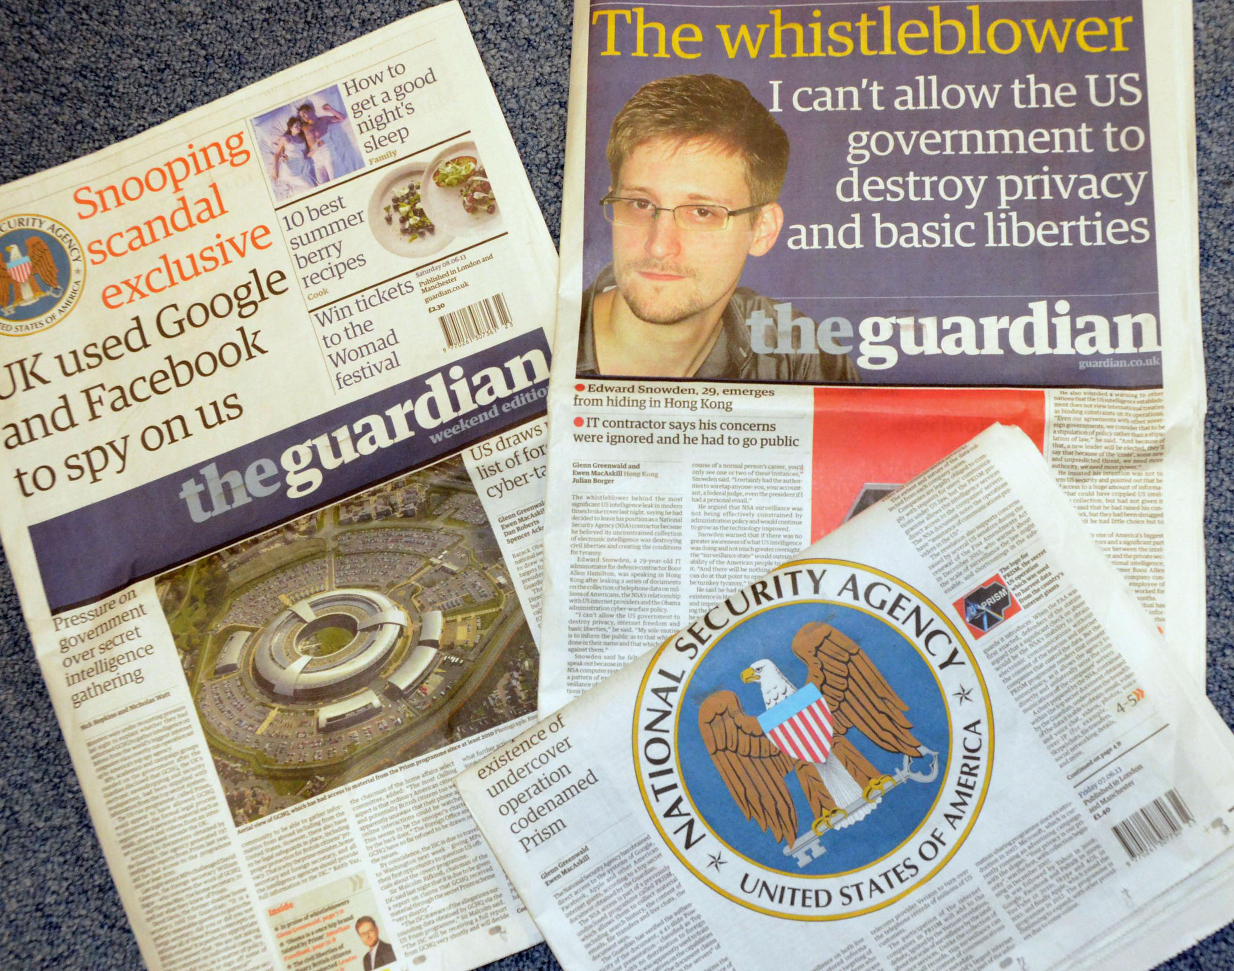

Slide 3
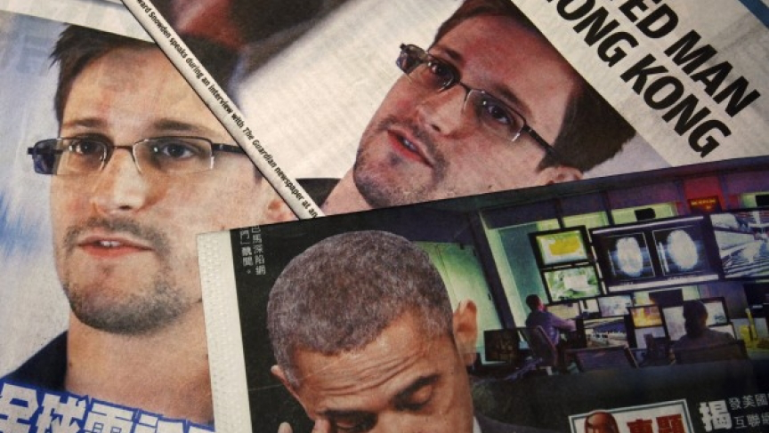
Worldwide debate over surveillance and privacy
http://www.pri.org/stories/2013-07-17/after-snowden-global-debate-over-privacy-vs-national-security-gaining-momentum

Slide 4
Goals
What is the public’s opinion about these revelations?
Are people worried about their online privacy?
In response, how do people change their online behavior?

Slide 5

Survey 772 writers in 50 countries
Writers have concern about government surveillance
They have started self-censoring
U.S. government reputation has been damaged as a protector of freedom of expression

Slide 6
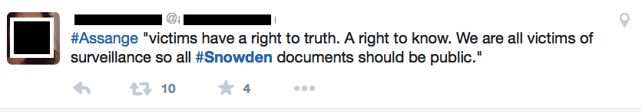
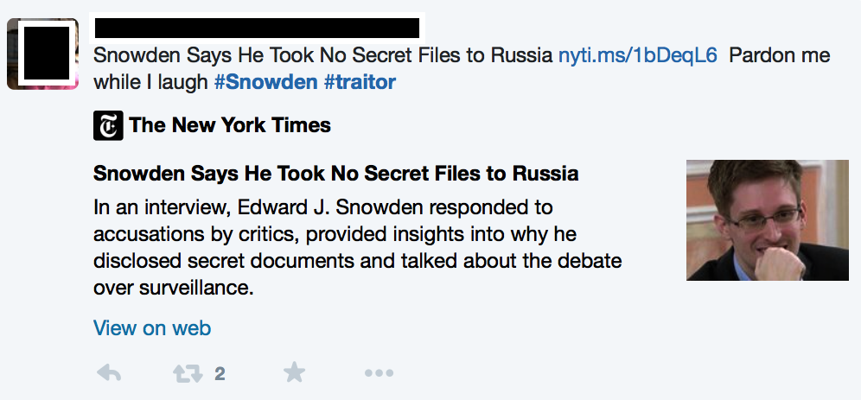
Twitter is a public sphere where people express about their opinions

Slide 7
Data Collection
Daily tweets with hashtags:
#nsa, #snowden, #edwardsnowden, #prism, #xkeyscore, #tempora and #ghcq
6 months: June 2013– November 2013
No data for 11/21/2013 – 11/24/2013 and 06/15/2013
Number of tweets: 338,285

Slide 8
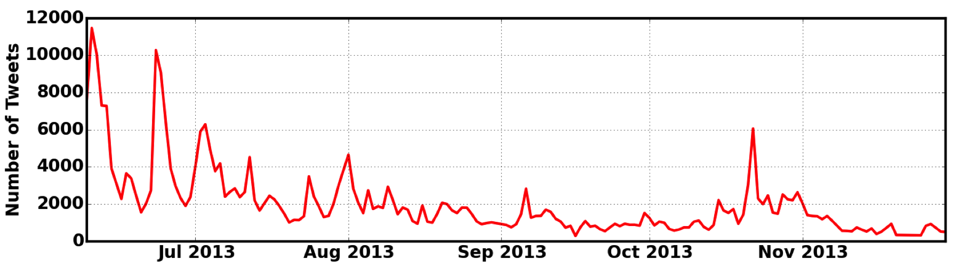
People on Twitter express their opinion more on Snowden, privacy revelations and NSA spying on other countries’ citizens
June 5– 7:
start of revelations on NSA collecting telephone records and Prism
June 9th-10th: Snowden goes public
Jun 17-21: Collaboration between GCPQ and NSA, June 23rd : Snowden goes to Moscow
Oct. 21 – 30: NSA spied on and monitored the phone calls of several world leaders, foreign citizens, and companies
Sept. 3- 6: Efforts for weaken data encryption, and, ability to access user data for most major smartphones
July 1- 3: Snowden applied for asylum
Aug. 1: NSA’s secret funding for GCHQ

Slide 9
How people feel about these revelations?
LabMT happiness score (Dodds et al.)
Each word gets a score between [1- 9]
Sentiment of tweets with related hashtags
Sentiment of random sample of tweets
The net sentiment score =
Avg. score of the tweets with related hashtags
– Avg. score of random sample of tweets

Slide 10
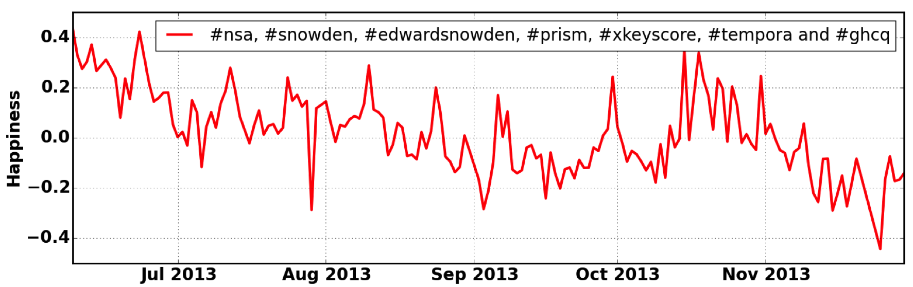
The Twitter net sentiment score is decreasing over time
July 3:
Snowden applied asylum to 20 foreign countries
And
He left Hong Kong due to potential threats on his safety and freedom
Nov. 22- 25:
NSA's desire for greater legal power and technological dominance
And
NSA infected 50,000 computer networks
Sep. 1-3:
NSA spied on Brazilian and Mexican presidents
And
NSA spies on Google and Petrobras
Oct. 4-9:
TOR network attacked by NSA
And
Canada spied on Brazil's Ministry of Mines and Energy

Slide 11
The Twitter net sentiment score is decreasing over time
Oct. 17- 28:
Lavabit and Silent Circle close down
And
NSA spies on world leaders
June 23: Snowden flies from Hong Kong to Moscow
July 12 :
Snowden meets with Russian rights groups
Aug. 8- 10:
Lavabit and Silent Circle close down

Slide 12
Content Analysis
Divide data weekly: 24 sets for 6 months
Log-odds-ratio (Monroe et al.)
Compare each weekly dataset with a random sample from the same week
Find statistically overrepresented words in each set of tweets

Slide 13
Weekly topic and sentiment shift
June 8– 14 | June 15– 21 | June 22– 30 | July 1- 7 | July 8- 14 | July 15- 21 | July 22- 30
0.34 | 0.22 | 0.21 | 0.02 | 0.14 | 0.04 | 0.08
Prism Spy Surveil. Whistleblo. tcot Protect Obama Encrypt Data Internet | Prism Spy Surveil. Whistleblo. Privacy tcot Obama Encrypt Data Traitor | Prism Spy Ecuador Russia Asylum Hong Kong Wikileaks Surveil. Whistleblo. Putin | Prism Asylum Surveil. Spy Venezuela Wikileaks Amend Moscow Presid Moral | Prism Asylum Spy Venezuela Surveil. Wikileaks Whistleblo. Russia Microsoft Privacy | Spy Asylum Russia Benghazi Carter Assang Wikileaks Impeach nixon democracy | Spy Amend Surveil. Russia Benghazi Whistleblo. Assang Amash tcot congress

Slide 14
Weekly topic and sentiment shift
Aug. 1– 7 | Aug. 8-14 | Aug. 15– 21 | Aug. 22– 31 | Sep. 1-7 | Sep. 8 -14 | Sep. 15-21
0.06 | 0.1 | -0.01 | -0.02 | -0.1 | -0.06 | -0.13
Spy Russia Asylum Surveil. Wikileaks Assang Obama Traitor Benghazi xkeyscor | Prism Obama Surveil. Spy Clapper Lavabit Benghazi Privacy Reform Encrypt | Prism Privacy Guardian Surveil. Spy ggreenwald Assang wikileaks Violat Detain | Prism Spy Surveil. Privacy Benghazi Guardian Violat Whistleblo. Document leak | Encrypt Spy Surveil. Privacy GCHQ Surprise Benghazi Sabotage Vendor Security | Spy Fingerprint Surveil. Privacy Data Fisa iphone5 sensor Benghazi israel | Prism Spy Privacy Surveil. Assang Darkhors creditcard Backdoor Benghazi Tor

Slide 15
Weekly topic and sentiment shift
Sep. 22-30 | Oct. 1-7 | Oct. 8-14 | Oct. 15– 21 | Oct. 22– 31
-0.03 | -0.05 | -0.07 | 0.18 | 0.09
Spy Privacy Never Fisa Data Southpark Wikileaks Whistleblo. ACLU Benghazi | Prism Tor Spy Privacy Anonymity Government_shutdown ioerror Guardian Benghazi FBI | Prism Moscow Spy GCHG Privacy DOJ Clan Assang Wikileaks Benghazi | Prism Poland Taiwan Hungary Portugal Denmark Spy Belgium France Greece | Prism Spy Surveil. Merkel Benghazi Privacy Obama OI Xfactoray yahoo

Slide 16
Weekly topic and sentiment shift
Nov. 1-7 | Nov. 8-14 | Nov. 15– 21 | Nov. 22– 30
-0.03 | -0.11 | -0.2 | -0.18
Spy Surveil. Wikileaks Privacy Germany Benghazi Youranonnews Asylum Anonymity Guardian | Prism Spy Privacy Wikileaks Benghazi Whistleblow Tcot Youranonnews Anonymity IR | Prism Surveil. Spy Privacy Benghazi unblock Redact Youranonnews Security Brad Heath | Prism Spy Surveil. G20 Discredit Doomsday Keiser Youranonnews Privacy Top secret

Slide 17
People talk about different topics when addressing “Snowden” vs. “NSA”
Applied topic modeling by Amaral lab
Topic 1:
Snowden, asylum, Russia, Whistleblower, Wikileaks, Assang, Ecuador, Putin, Venezuela, Hero, Leaker, breaking, Hong Kong, Russian, ….
Topic 2:
NSA, Spy, Surveillance, Data, Leak, Call, Secret, Report, Phone, Program, Google, GCHQ, Collect, Congress, Reveal, Citizen, Facebook, FBI, Court, Access, fisa, Document, Microsoft, Companies, German, Share, Monitor, Million, File, Target, Private, Domestic, ….

Slide 18
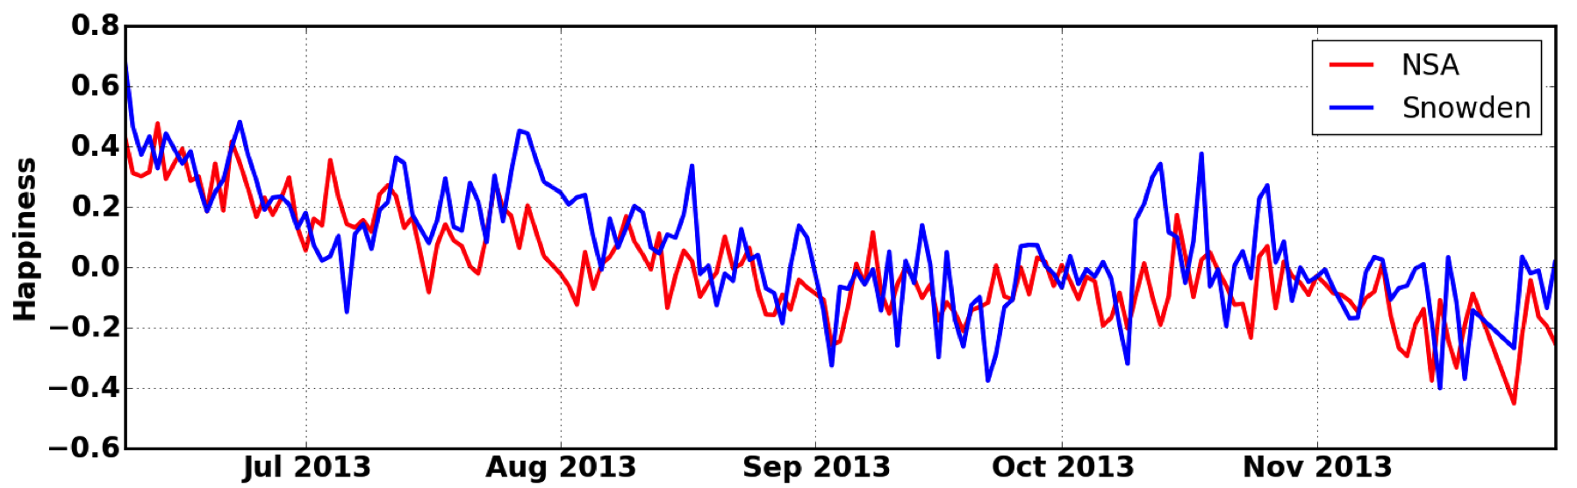
Snowden vs. NSA
Two exclusive sets:
Tweets with hashtags #snowden/ #edwardsnowden (98,721 tweets)
Tweets with hashtag #nsa (153,386 tweets)

Slide 19
Summary
People vocally reacted very fast to the revelations.
Overtime people are getting more upset and angry about the issue
People expressed opinions about their online privacy

Slide 20
Future work
Demographics
Location
Language
How this change in the perceived level of privacy affect people’s online behavior?
Do Revelations about Internet Security have a Chilling Effect?

Slide 21
Questions?

